Slide 1
DAG Construction, Reordering and labeling

Slide 2
Directed Acyclic Graph - DAG
Useful data structures for implementing transformation on basic blocks
Gives detail of how the value is computed for each statement of the basic block

Slide 3
DAG - Application
Common sub-expression
Which names are inside the block but evaluated outside
Which statements of a block gets their value computed outside the block

Slide 4
DAG construction
Leaves are labeled by unique identifiers – variable or constants – represent r-values
Interior nodes are labeled by an operator
Nodes are optimally given a sequence of identifiers

Slide 5
DAG construction algorithm
Input: Basic block
Output: DAG having label for each node – operator or variables . For each node a list of attached identifiers
(i) x := y op z
(ii) x := op y
(iii) x := y
If node (y) is undefined create a label ‘y’ and let it be node (y) and so for node (z) if ‘z’ is not there

Slide 6
DAG algorithm
In case (i) check if there is a node labelled ‘op’ whose left and right children are ‘y’ and ‘z’ respectively. If not create such a node and let it be ‘n’. In case (ii) ignore ‘z’ and do the same thing. In case (iii) let the node(y) be ‘n’
Delete x from the list of attached identifiers for node(x). Append ‘x’ to the list of attached identifiers for the node ‘n’ and set node(x) to n

Slide 7
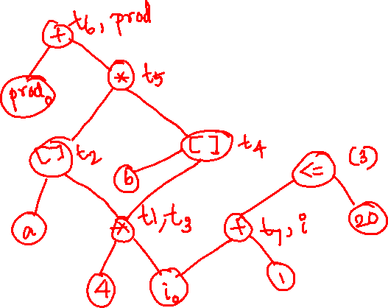
Example
t1 := 4 * i
t2 := a[t1]
t3 := 4 * i
t4 := b [t3]
t5 := t2 *t4
t6 := prod + t5
prod := t6
t7 := i+1
i := t7
If i <= 20 goto (3)

Slide 8
DAG
t5
*
t4
[ ]
b
t2
[ ]
a
*
t1, t3
4
i

Slide 9
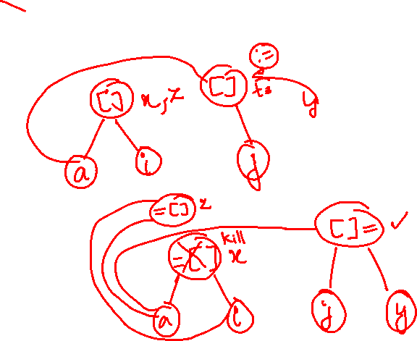
Arrays, Pointers and Procedures
x := a[i]
a[j] := y
z := a[i]
Same as
x := a[i]
z := x
a[j] := y

Slide 10
Arrays, Pointers and Procedures
If i = j, then the value chosen is different for ‘z’
So, while processing array, we kill all nodes labeled [] so, that confusion is prevented
Similar scenarios is adopted for pointers and procedures

Slide 11
Modification to algorithm
Evaluation of or assignment to an array must follow the previous assignment if there is one
Any assignment to an array element follow any previous evaluation of a
Any use of an identifier must follow the previous procedure call or indirectly through a pointer if there is one
Any procedure call or indirect assignment through a pointer must follow all previous evaluations of an identifier

Slide 12
Code generation from DAG
Rearranging the order
Heuristic ordering for DAGs
Optimal ordering for Trees
Labeling the tree for register
Tree traversal to generate code

Slide 13
Rearranging the order
Changing the order of independent statements to efficiently utilize the registers.
Reduce the final cost of assembly level code

Slide 14
Node listing algorithm
while unlisted interior nodes remain do begin
select an unlisted node n, all of whose parents have been listed;
list n;
while the leftmost child m of n has no unlisted parents
and is not a leaf do
/* since n was just listed , m is not yet listed*/
begin
list m;
n = m
end
end

Slide 15
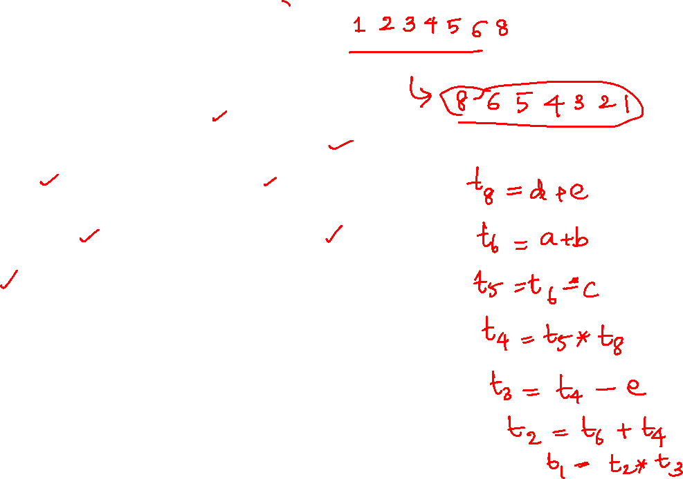
Example
1
*
2
-
3
+
4
*
5
8
-
+
6
7
11
+
c
12
d
e
9
a
b
10

Slide 16
Example
Ordering of the sequence 1234568
Reversed 8654321
Evaluate t8 first
t8 := d +e
t6 := a +b
t5 := t6 – c
t4 := t5 * t8
t3 := t4 – e
t2 := t6 + t4
t1:= t2 + t3

Slide 17
Example
t4
-
t1
+
-
t3
a
b
e
+
t2
c
d

Slide 18
Choice of Evaluation Order
When instructions are independent, their evaluation order can be changed to utilize registers and save on instruction cost
MOV a,R0 ADD b,R0
MOV c,R1 ADD d,R1
MOV R0,t1 MOV e,R0 SUB R1,R0 MOV t1,R1 SUB R0,R1 MOV R1,t4
t1:=a+b t2:=c+d t3:=e-t2 t4:=t1-t3
a+b-(c+d)*e

Slide 19
Reordered instructions and code
t2:=c+d t3:=e-t2 t1:=a+b t4:=t1-t3
MOV c,R0 ADD d,R0 MOV e,R1 SUB R0,R1 MOV a,R0 ADD b,R0 SUB R1,R0 MOV R0,t4

Slide 20
Labeling algorithm
“left leaf” means a node that is a leaf and the left most descendent of its parent. All other leaves are referred to as “right leaves”.
Labeling can be be done by visiting node in a bottom up order so that a node is not visited until all its children all labeled.

Slide 21
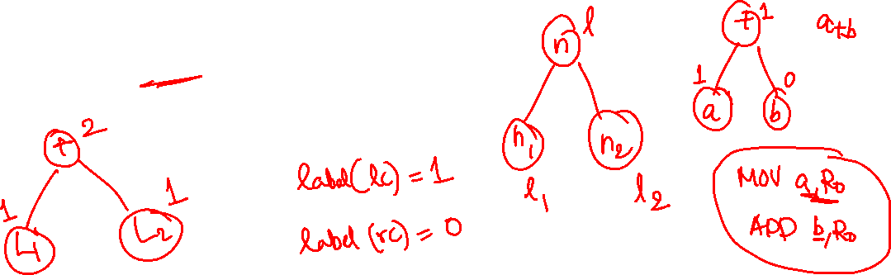
Labeling algorithm
The order in which the parse tree nodes are created is suitable if the parse tree is used as intermediate code, so in this case the labels can be computed as syntax directed translation.
Binary node, n
label (n) = max (l₁, l₂) if l₁ != l₂
l₁ + 1 if l₁ == l₂

Slide 22
Label computation
Post order traversal is used
Node a is labelled 1 since it is the left most leaft node.
b is labelled 0 as it is the right child
Parent of a, b is assigned max(1,0) which is 1

Slide 23
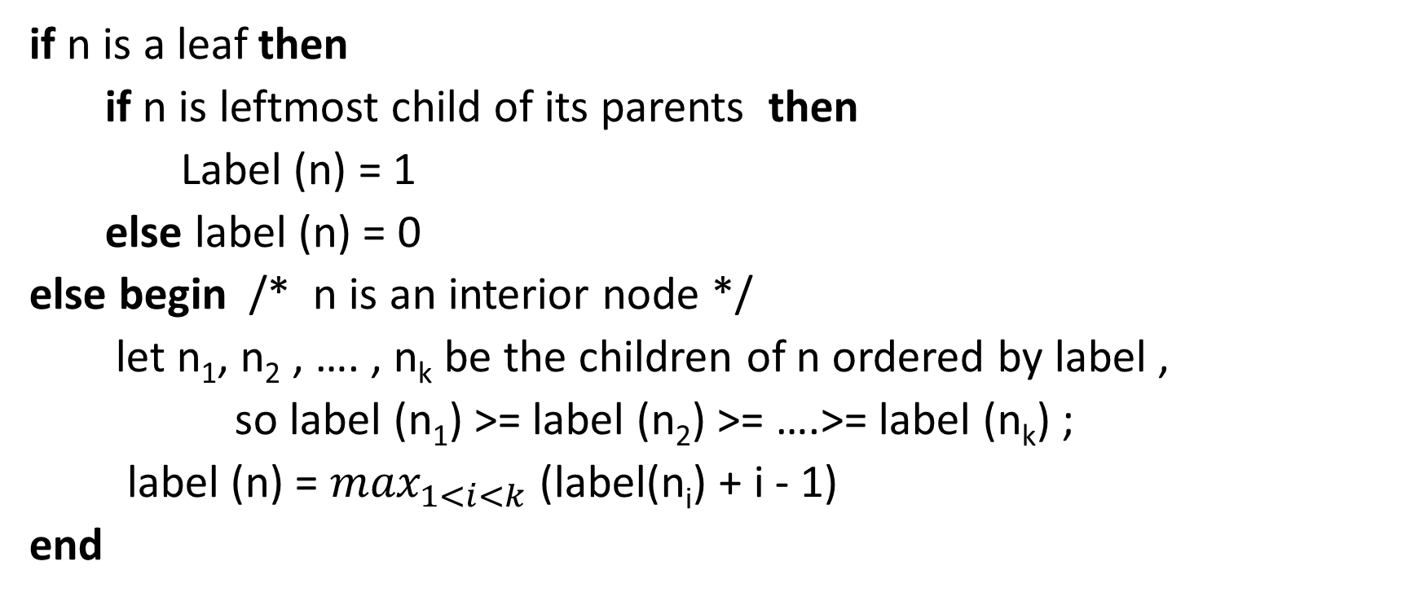
Labeling algorithm
if n is a leaf then
if n is leftmost child of its parents then
Label (n) = 1
else label (n) = 0
else begin /* n is an interior node */
let n₁, n₂ , …. , n_{k} be the children of n ordered by label ,
so label (n₁) >= label (n₂) >= ….>= label (n_{k}) ;
label (n) = $\max_{1<i<k}$ (label(n_{i}) + i - 1)
end

Slide 24
Example
t4
-
t1
+
-
t3
a
b
e
+
t2
c
d

Slide 25
Labelled Example
2
t4
1
t1
t3
2
1
1
0
a
b
e
t2
1
0
1
c
d

Slide 26
Label computation
The labelling is carried out till the root and the value at a node indicates the number of registers required to compute the node

Slide 27
Code generation from DAG
Uses a recursive procedure gencode(n) on a labelled DAG
Consider code generation based on the labels assigned to the nodes
Use stack “rstack” to allocate registers. Initially, rstack contains all available registers.
When gencode returns, it leaves the registers on rstack in the same order it found them.
The function swap(rstack) interchanges the top two registers on rstack.

Slide 28
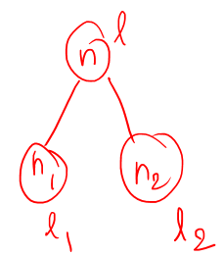
Five cases to generate CODE
Case 0: n is a leaf and the leftmost child of its parent. Therefore, we generate just a load instruction.
Case 1: we have a subtree of the form for which we generate code to evaluate n₁ into register R=top(rstack) followed by the instruction
op name, R.
name

Slide 29
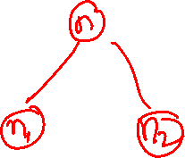
Five cases to generate CODE
Case 2: A subtree of the form where n₁ can be evaluated without stores but n₂ is harder to evaluate than n₁ as it requires more registers. For this case, swap the top two registers on rstack, then evaluate n₂ into R=top(rstack). We remove R from rstack and evaluate n₁ into S = top(rstack). Then generate the instruction op R, S, which produce the value of n in register S. Another call to swap leaves rstack as it was when this call of gencode began.

Slide 30
Five cases to generate CODE
Case 3: It is similar to case 2 except that here the left subtree is harder and is evaluated first. There is no need to swap registers here.
Case 4: It occurs when both subtrees requires r or more registers to evaluate without stores. Since we must use a temporary memory location, we first evaluate the right subtree into the temporary T, then the left subtree, and finally the root.

Slide 31
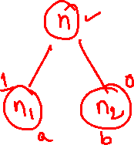
Algorithm
Procedure gencode(n);
Begin
/* case 0 */
if n is a left leaf representing operand name and n is the leftmost child of its parent then
print ‘MOV’ || name || ‘,’ || top(rstack)
else if n is an interior node with operator op, left child n₁, and right child n₂ then
/* case 1 */
if label(n₂) = 0 then begin
let name be the operand represented by n₂;
gencode(n₁);
print op || name || ‘,’ || top(rstack)
end

Slide 32
Algorithm
/* case 2 */
else if 1 ≤ label (n₁) < label(n₂) and label(n₁) < r then begin
swap(rstack);
gencode(n₂ );
R := pop(rstack); /* n₂ was evaluated into register R */
gencode(n₁);
print op || R || ‘,’ || top(rstack);
push(rstack, R);
swap(rstack)
end

Slide 33
Algorithm
/* case 3 */
else if 1 ≤ label (n₂) ≤ label(n₁) and label(n₂) < r then begin
gencode(n₁);
R := pop(rstack); /* n₁ was evaluated into register R */
gencode(n₂);
print op || top(rstack) || ‘,’ ||R;
push(rstack, R);
end

Slide 34
Algorithm
/* case 4, both labels ≥ r, the total number of registers */
else begin
gencode(n₂ );
T := pop(tstack);
Print ‘MOV’ || top(rstack) || ‘,’ || T;
gencode(n₁);
push(tstack, T);
print op || T || ‘,’ || top(rstack)
end
end

Slide 35
Example
2
-
t4
1
+
t1
-
t3
2
1
1
0
a
b
e
+ t2
1
0
1
c
d

Slide 36
Code
gencode(t₄) [R1 R0] // case 2
gencode(t₃) [R0 R1] // case 3
gencode(e) [R0 R1] // case 0
print MOV e, R1
gencode(t₂) [R0] // case 1
gencode(c) [R0] // case 0
print MOV c, R0
print ADD d, R0
print SUB R0, R1 [R0 R1]
gencode(t₁) [R0] // case 1
gencode(a) [R0] // case 0
print MOV a, R0
print ADD b, R0
print SUB R1, R0

Slide 37
Multi-register operation
To support multi-register the label algorithm is changed
label(n) = max (2, l₁, l₂) if l₁ ≠ l₂
= l₁ + 1 if l₁ = l₂
Notes:
Till now, single register involved in operation like MOV A, R1.
Register for left and right subtree.

Slide 38
Algebraic Properties
Use to swap left and right nodes to effectively use the code generation algorithm
Common sub-expression need not be recomputed.
Notes:
Use for Dag computation for effective code gen to incorporate associative and commutative property.

Slide 39
Peephole Optimization
Examines a short sequence of target instructions in a window (peephole) and replaces the instructions by a faster and/or shorter sequence when possible
Applied to intermediate code or target code

Slide 40
Typical Optimization
Redundant instruction elimination
Flow-of-control optimizations
Algebraic simplifications
Use of machine idioms

Slide 41
Eliminating Redundant Loads and Stores
Consider MOV R0,a MOV a,R0
The second instruction can be deleted, but only if it is not labeled with a target label
Peephole represents sequence of instructions with at most one entry point
The first instruction can also be deleted if live(a)=false

Slide 42

Deleting Unreachable Code
Unlabeled instructions immediately following an unconditional jump can be removed
if 0!=1 goto L2
goto L2
b := x + y …
b := x + y …

Slide 43
Branch Chaining
Shorten the length of branches by modifying target labels
if a==0 goto L2
if a==0 goto L3
b := x + y …
b := x + y …
L2: goto L3
L2: goto L3

Slide 44
Flow-of-Control Optimizations
Remove redundant jumps
Possible to eliminate the statement L1:goto L2 provided it is preceded by an unconditional jump
… goto L1
…
goto L2
… L1:goto L2 …
L1:goto L2 …

Slide 45
Suppose there is only one jump to L1 and L1 is preceded by an unconditional goto
goto L1
…
if a==0 goto L2
goto L3
…
L1:if a==0 goto L2 L3:
L3:

Slide 46
Reduction in strength: replace expensive arithmetic operations with cheaper ones
Use of machine idioms
… a := x ^ 2 b := y / 8
… a := x * x b := y >> 3
… a := a + 1
… inc a

Slide 47
Other Peephole Optimizations
Algebraic simplifications
… a := a + 0 b := b * 1
…

Slide 48
Summary
DAG construction
DAG in the context of array and pointers
Heuristic reordering of statements for reducing instruction costs
Labeling algorithm to identify the number of registers required to compute a node
Code generation

